Slide 1

Embedded Software Programming
Ambuj Varshney
ambujv@nus.edu.sg
Notes:
++ Thank you for inviting me to give this talk
++ In this talk, I will present a pathway that can enable us to make wireless embedded systems ubiquitous. I will describe my previous research efforts that tackle the critical challenges that limit the growth of wireless embedded systems. These are related to the growing energy asymmetry that exists between sensing, computation and communication blocks on these platforms.
++ Finally, I will conclude my talk by covering the research agenda that I would like to work on as a faculty member.

Slide 2
Roadmap of the lecture today
Let us recall what was covered in the last lecture
Interfacing I2C sensors on Arduino using library
Clock and Timers
Battery Capacity
Low-Power communication and backscatter
Notes:
Here is the roadmap of the major topics that I am going to cover during the presentation. We have already covered the exponential growth of the internet of things; next, I will talk about the critical energy challenge that can severely hinder this massive growth and preventing us from realising this immense economic value enabled by the IoT.

Slide 3
Course Information
Notes:
++ Over the past few years, I have designed several backscatter and beyond backscatter systems that precisely overcome these critical challenges that have limited the widespread deployment of backscatter on IoT devices.
++ The research vision that I have pursued and would like to pursue as a faculty member is to enable a massive deployment of IoT devices by bridging the energy asymmetry between sensing, computation and communication blocks by designing novel platforms and communication mechanisms. I am going to describe some of my research contributions next.

Slide 4
Administrative Stuff
Deadline for project problem, seminar paper selection: 10th March 2024
Equipment for Project: End of recess week (Before 4th March 2024)
List of papers for seminar (Partially updated on webpage)
Theme for term paper (Will be updated by end of this week)
Project can be done in a group of two. We would need statement of work
Term paper, Student Seminar are INDIVIDUAL tasks
Notes:
Backscatter communication actually help us overcome this limitation

Slide 5
Important Deadlines
Event | Date
Lectures | Starting Week 1 (15th January)
Student seminar paper selection | 10th of March 2024
Finalising project statement | 10th of March 2024
Student seminars | Lectures from 18th March
Project presentation | 15th April 2024
Term paper submission | 19th April 2024
Project submission | 19th April 2024

Slide 6
Roadmap of the lecture today
Let us recall what was covered in the last lecture
Interfacing I2C sensors on Arduino using library
Clock and Timers
Battery Capacity
Low-Power communication and backscatter
Notes:
Here is the roadmap of the major topics that I am going to cover during the presentation. We have already covered the exponential growth of the internet of things; next, I will talk about the critical energy challenge that can severely hinder this massive growth and preventing us from realising this immense economic value enabled by the IoT.

Slide 7
Let us recall what we covered in the last lecture
Notes:
++ Over the past few years, I have designed several backscatter and beyond backscatter systems that precisely overcome these critical challenges that have limited the widespread deployment of backscatter on IoT devices.
++ The research vision that I have pursued and would like to pursue as a faculty member is to enable a massive deployment of IoT devices by bridging the energy asymmetry between sensing, computation and communication blocks by designing novel platforms and communication mechanisms. I am going to describe some of my research contributions next.

Slide 8
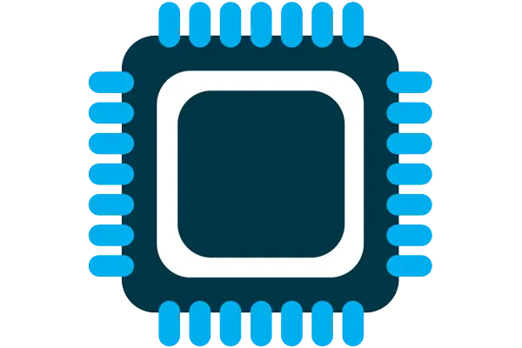
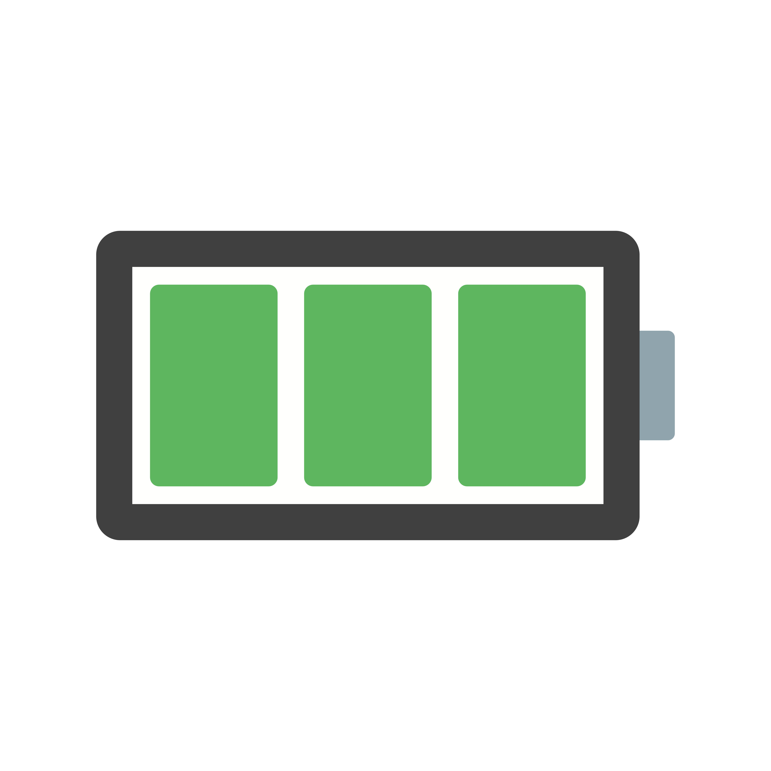


What are components of internet of things
Computation and Storage
Sensing and Actuation
Power
Wireless Connectivity
Notes:
First, we look at the computational elements, and these consist of a microcontroller or an FPGA. Today, we find that these computational elements consume at least one order of magnitude higher power consumption when compared to the commonly used sensors.
However, we also find that microcontrollers are increasingly becoming energy efficient. We investigate a typical microcontroller that has been used in sensor platforms over the past two decades. We find that energy efficiency has improved by almost two orders of magnitude. Some of the present-generation microcontrollers, such as Ambiq Apollo4 consume just 3 uA/MHz than 330 uA for MSP430 used on platforms such as TelOS B.
If the trend continues, we can expect the microcontrollers to catch up with the sensors and become energy-efficient. This significant improvement is that the digital components are increasing becoming efficient as they follow moore’s law.

Slide 9
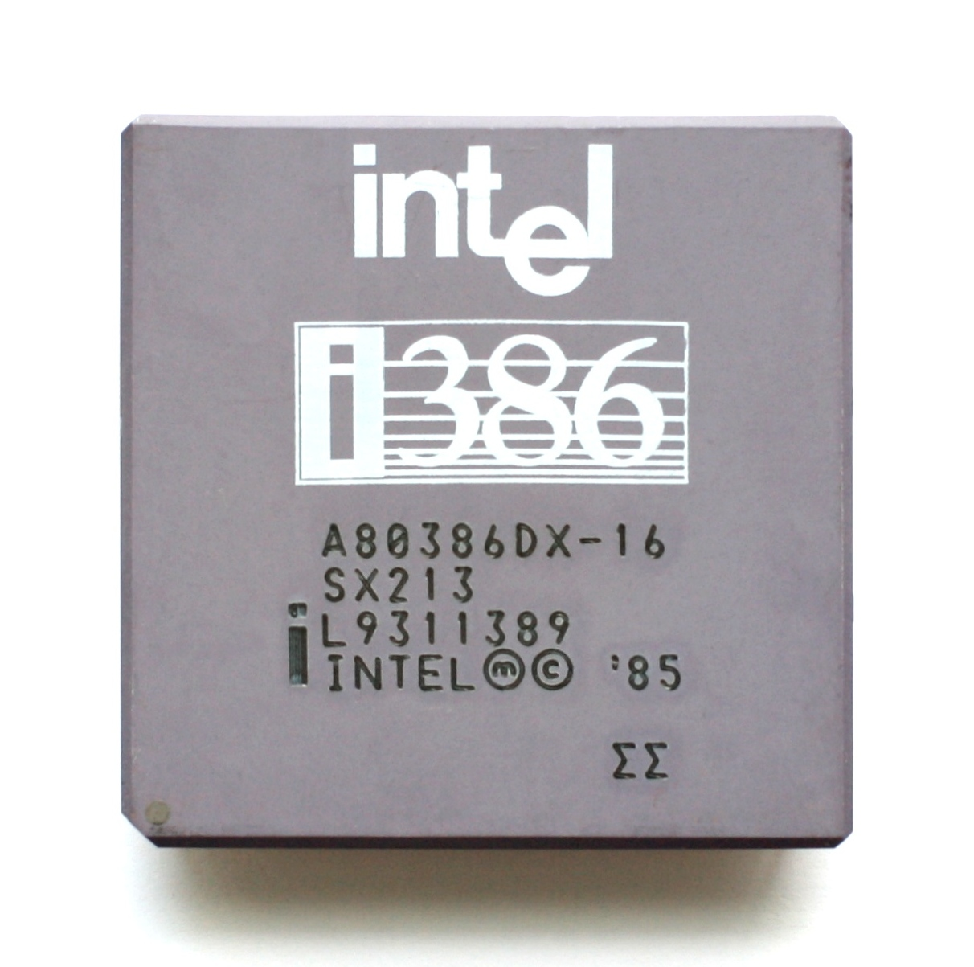
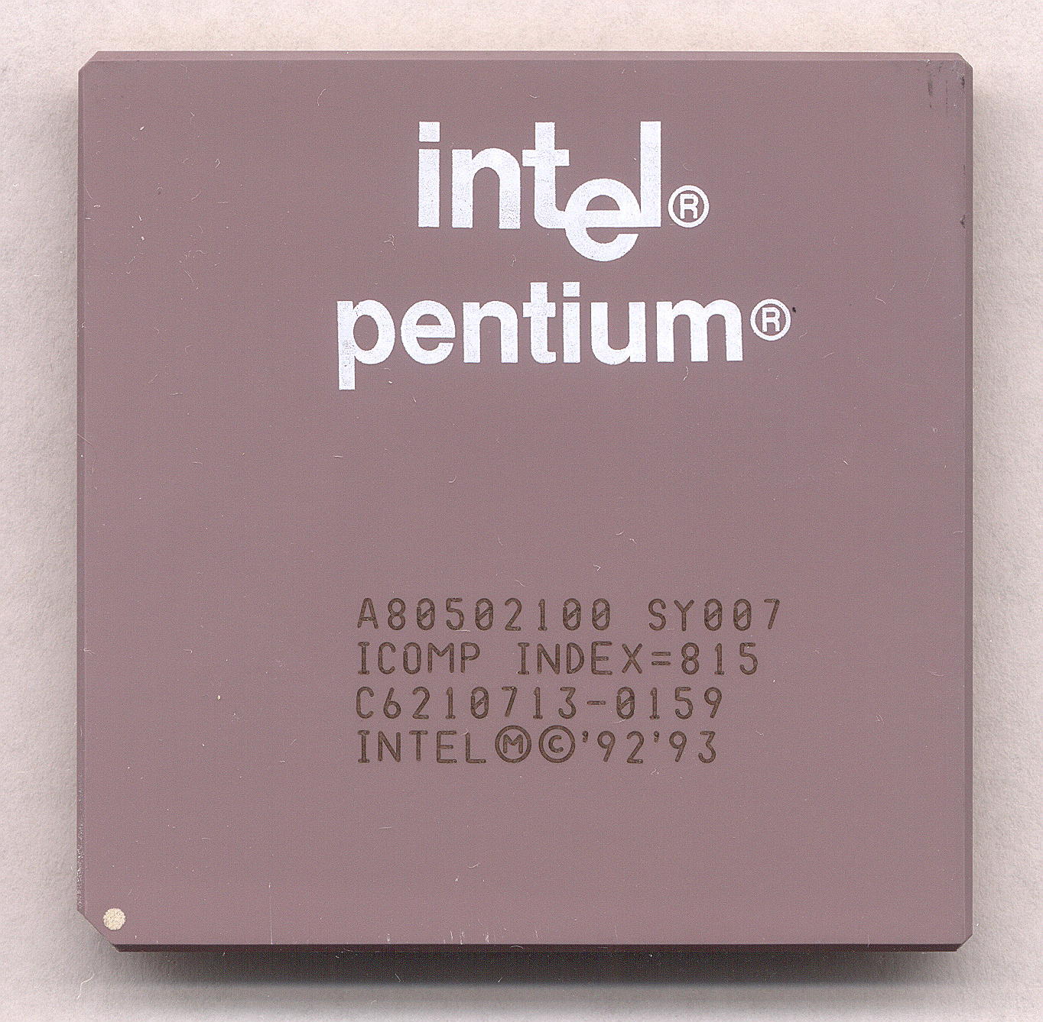
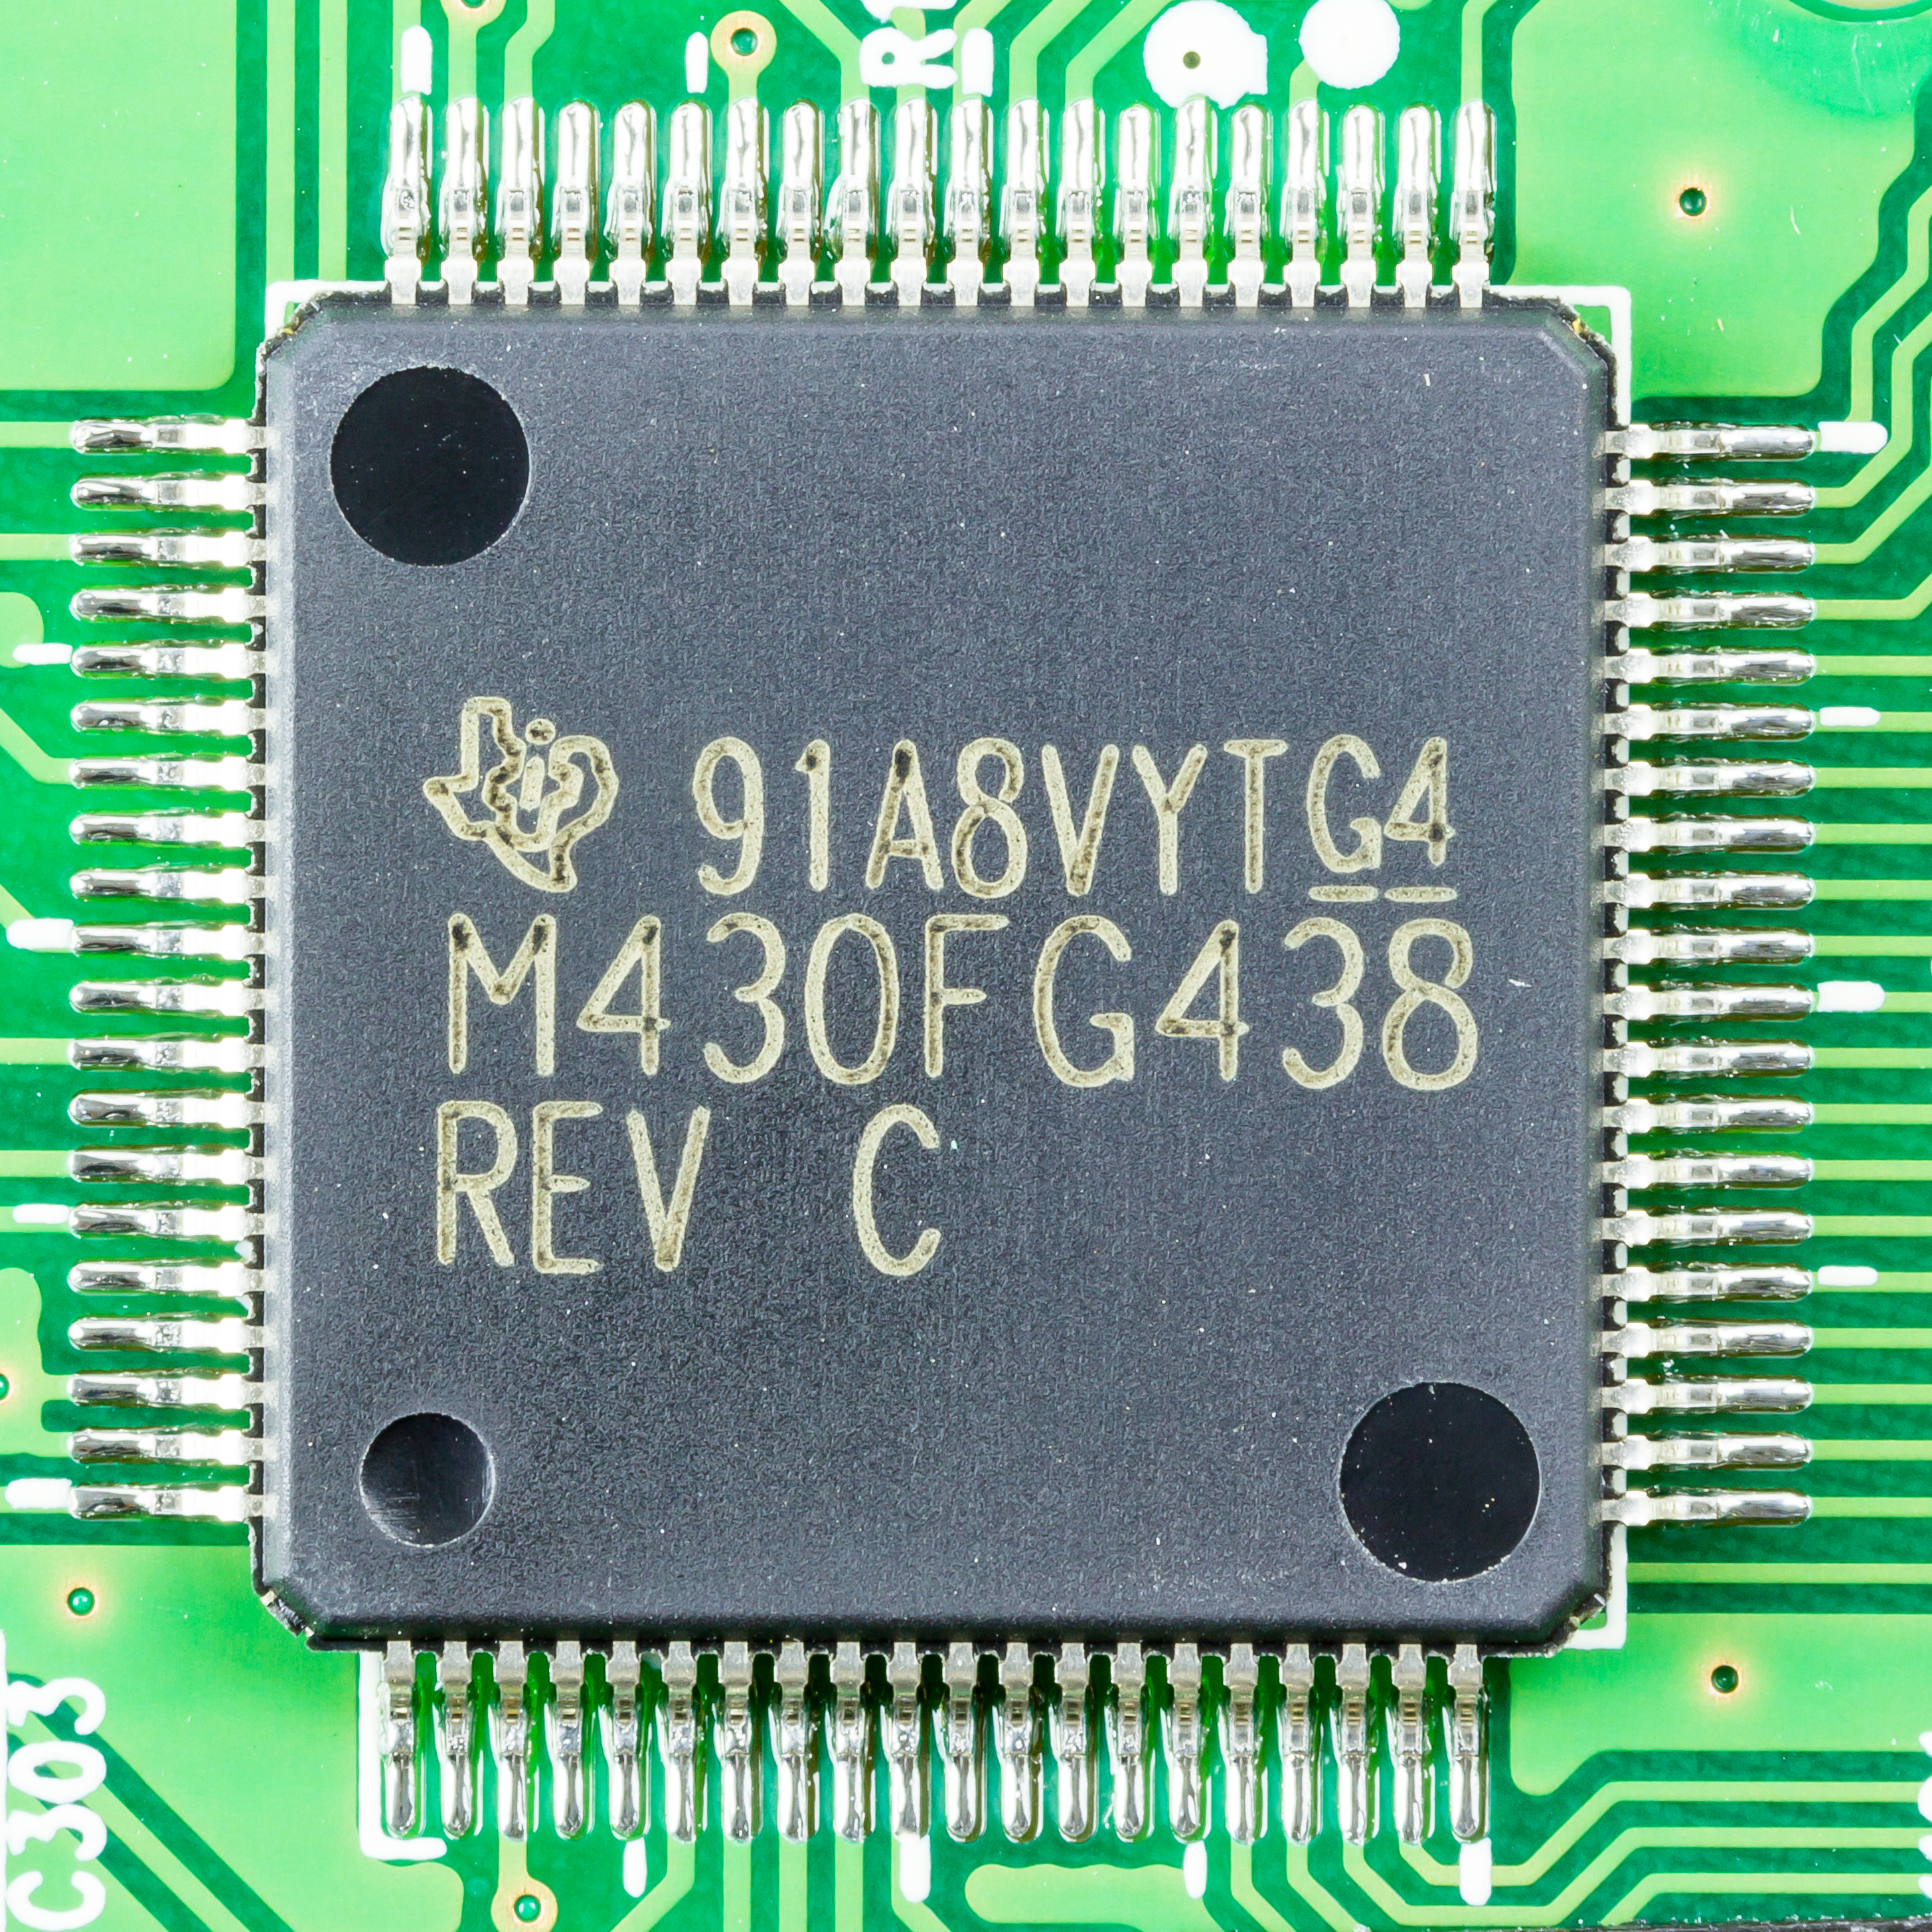
What is heart of computers and internet of things
Microprocessor (Computers)
They usually don’t have peripherals or memory
CPU + Pins (No memory, peripherals)
Your computer typically has a microprocessor
Microcontrollers (Internet of Things)
Memory + Peripherals + CPU + Pins
Peripherals: Specialized hardware units within the chip
Notes:
Backscatter communication actually help us overcome this limitation

Slide 10
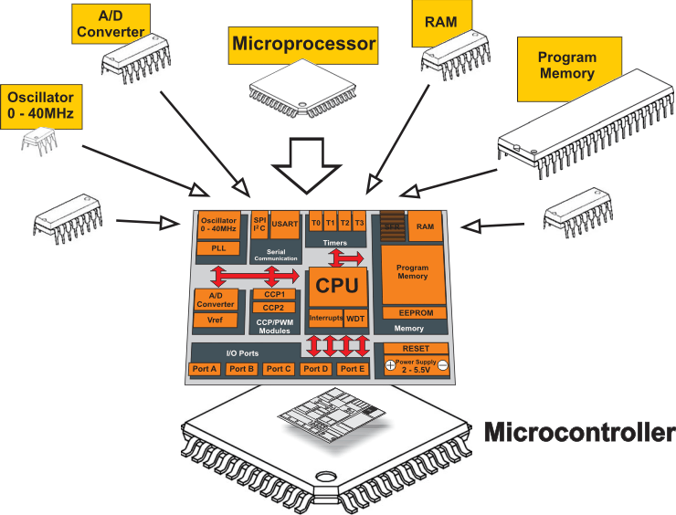
What is a microcontroller? Microprocessor + Peripherals + Memory + Pins + ?
Microcontroller
Processor
Peripherals
Pins
Memory
Notes:
Backscatter communication actually help us overcome this limitation

Slide 11
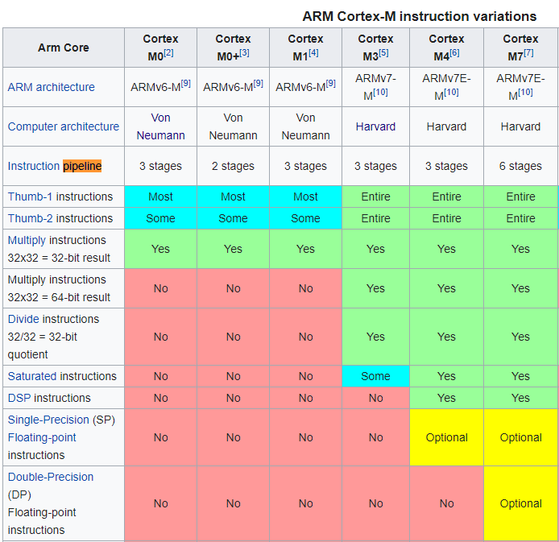
ARM Cortex M Series
A number of options for increasing capabilities
In practice:
Cortex-M0+ for low-end systems
Coretx-M4 for high capability systems

Slide 12
Modern system-on-chips (10s-?)
Focus: increase memory and capability
Include radios in the same chip
Machine learning accelerators and other dedicated functionality
nRF51 and nRF52 series
32-bit ARM microcontrollers (Cortex M)
Include 2.4 GHz radio: Bluetooth Low Energy and 802.15.4/Thread
Others have followed this same path
TI CC26XX
Apollo3
STM32WL

Slide 13
What are examples of microcontroller peripherals
Hardware modules that perform some action
Common examples
Control digital input and output pins
Read analog inputs
Send messages in a given wire protocol (UART, SPI, I2C)
Set and check timers
Less common examples
Cryptography accelerators
Complicated wire protocols (USB, CAN)
Wireless radios (BLE, 802.15.4, WiFi)

Slide 14
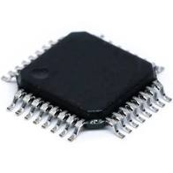
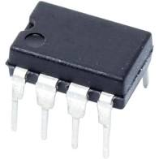
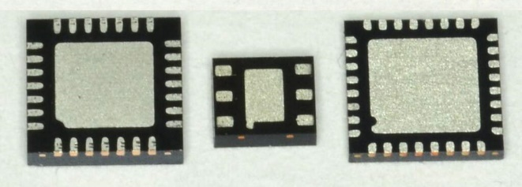
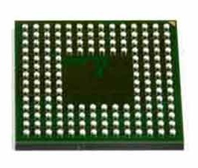
Connecting peripherals on microcontrollers
Peripherals need to electrically connect to outside world
Attach to pins on the exterior of the chip
More pins allow for more connections
At increased cost and size
Pin layouts can add more pins for cheaper
But make soldering and debugging difficult
Peripherals need to connect to external pins
Modern microcontrollers allow any-to-any connections

Slide 15
Memory on microcontroller (hierarchy)
Registers
RAM
ROM

Slide 16
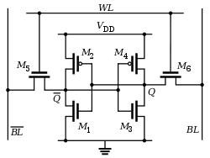
Example of volatile memory: SRAM
Same design as registers in traditional computer systems
No need to refresh it -> lower energy costs
Tradeoff:
More expensive
Physically larger

Slide 17
Example of non-volatile memory: Flash
Same design as SSDs and Flash drives
Memory is stored with no energy costs
Reading is lowish energy and quick
Writing is high energy and very slow
Writing also has to occur in blocks (e.g. 512 bytes)
Concern: Flash has a limited lifetime ~10,000 writes
Only writing to Flash when you load code? Essentially forever
Recording data to Flash every second? 2.8 hours

Slide 18
Emerging non-volatile memories FRAM , MRAM
FRAM and MRAM are both potential flash memory replacements
Non-volatile in nature
High to infinite write/erase cycles
Lower energy costs for writing and reading
The two-use unrelated magnetic techniques for data storage
Starting to appear in microcontrollers
TI MSP430s have used 16 kB FRAM
Apollo4 (ARM Cortex-M4F) has 2 MB of MRAM

Slide 19
How do you select microcontrollers?
Some of the metrics to be considered in making a selection:
Power consumption
Clock frequency
IO pins
Memory
Internal functions
Others? What else?

Slide 20




Serial Peripheral Interface (SPI)
Device 1
Serial, synchronous, bus communication protocol
Single controller with multiple peripherals
Within a circuit board
High-speed communication
Multiple Mbps
Serial Data In Serial Data Out Serial Clock
$$\overline{\text{Chip} \text{Select} }$$
Microcontroller
Device 2
Serial Data Out Serial Data In Serial Clock
$$\overline{\text{Chip} \text{Select} }$$
$$\overline{\text{Chip} \text{Select} }$$
$$\overline{\text{Chip} \text{Select} }$$
Serial Data In Serial Data Out Serial Clock
$$\overline{\text{Chip} \text{Select} }$$
Device 3
Serial Data In Serial Data Out Serial Clock
$$\overline{\text{Chip} \text{Select} }$$

Slide 21
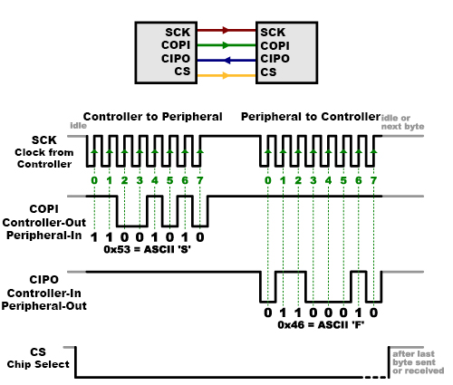
Example of SPI communication
Transactions usually in multiples of bytes (as many as needed)
Bytes are sent LSB first
No need for framing bits (start/stop)
CS handles that

Slide 22
What is the maximum data rate on SPI?
No particular requirements
Speed can go as fast as your clock and line capacitance can handle
Datasheet for devices will specify their speeds
Sort of standards (less so than UART, for example)
700 kbps
3.4 Mbps
10 Mbps

Slide 23
What are Pros and Cons for SPI?
Pros
Faster throughput (and no overhead)
No restrictions on data frame
No addressing requirements or word size assumptions
Full duplex transfers
Cons
Many pins: 3+N (for N peripherals)
CS line scales linearly (other signals are a bus)
Controller must initiate all transfers
Not designed for multi-controller scenarios

Slide 24
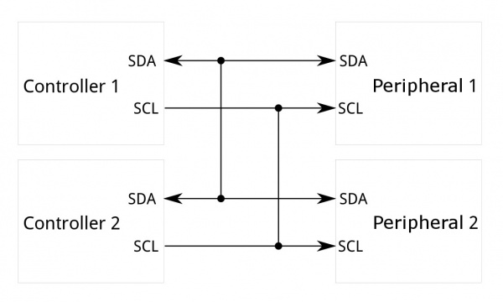
Inter-Integrated Circuit (I²C)
Two-wire, synchronous, bus communication
Ubiquitous in the embedded world
De-facto standard for sensors
Invented and patented by Phillips (now NXP)
Patent expired in 2004
Also known as Two-Wire Interface (TWI)

Slide 25
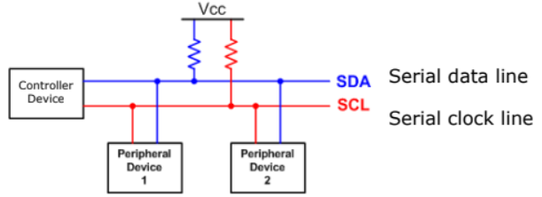
An overview of Inter-Integrated Circuit (I²C)
SDA – Serial Data
SCL – Serial Clock
Usually 100 kHz or 400 kHz
Communication is a shared bus between all controller(s) and peripheral(s)

Slide 26
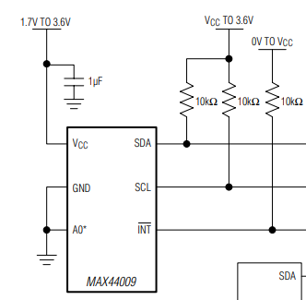
Each I2C device on a bus must have a different address
Shared addresses would cause both to respond
ICs often have one or more address pin(s) used to select bit(s) of address
0 pins: only one may be on bus
1 pin: two may be on bus
2 pins: four may be on bus
If no address pins (or not enough), need an I2C address translator chip
A0 is low: address 1001010x
A0 is high: address 1001011x

Slide 27
I2C use cases
Various sensors
Usually low to medium speed
Even relatively high speed stuff often has I2C for convenience
Accelerometers and microphones
Often with intelligent filtering built in
Communication between microcontrollers
Either can act as the Controller when necessary
Commonly exists internally within smartphones and laptops too
Light sensors, Temperature sensors, etc.

Slide 28
I2C Pros and Cons
Pros
Wiring is simple
Only uses two pins
Very widely supported
Cons
Relatively slow communication rate
Speed versus power use tradeoff (due to pull-down resistor)
Open collector makes debugging difficult

Slide 29
Roadmap of the lecture today
Let us recall what was covered in the last lecture
Interfacing I2C sensors on Arduino using library
Clock and Timers
Battery Capacity
Low-Power communication and backscatter
Notes:
Here is the roadmap of the major topics that I am going to cover during the presentation. We have already covered the exponential growth of the internet of things; next, I will talk about the critical energy challenge that can severely hinder this massive growth and preventing us from realising this immense economic value enabled by the IoT.

Slide 30
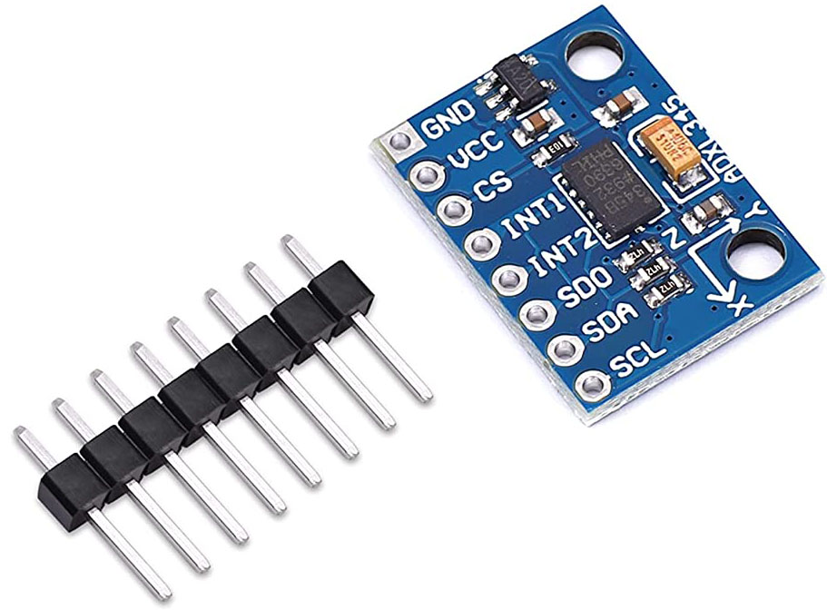
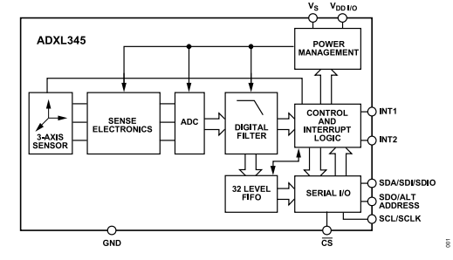
Example of interfacing sensor through I2C: ADXL345
ADXL345 is an example of an accelerometer supporting I2C Protocol
Current consumption: 23 microampere, 0.1 microampere in standby mode
Resolution of the accelerometer sensor: 10 to 13 bits
Interfacing with embedded systems: Through busses I2C and SPI
Notes:
Backscatter communication actually help us overcome this limitation

Slide 31
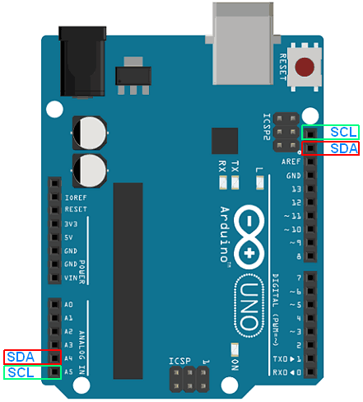
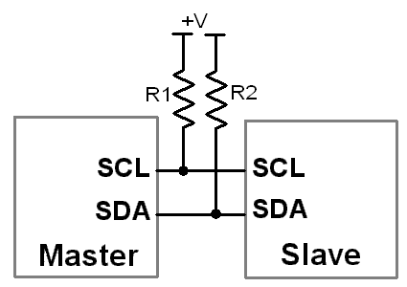
Example of interfacing sensor through I2C: ADXL345
Arduino provides library support for I2C Protocol
Do not need to know all the intrinsic details of the I2C protocol and implementation
Include: <Wire.h> to use the I2C library
Notes:
Backscatter communication actually help us overcome this limitation

Slide 32
Example of interfacing sensor through I2C: ADXL345
Arduino provides library support for I2C Protocol
Do not need to know all the intrinsic details of the I2C protocol and implementation
Include: <Wire.h> to use the I2C library
Notes:
Backscatter communication actually help us overcome this limitation

Slide 33
Example of interfacing sensor through I2C: ADXL345
Arduino provides library support for I2C Protocol
Do not need to know all the intrinsic details of the I2C protocol and implementation
Include: <Wire.h> to use the I2C library
Notes:
Backscatter communication actually help us overcome this limitation

Slide 34
Example of interfacing sensor through I2C: ADXL345
Arduino provides library support for I2C Protocol
Do not need to know all the intrinsic details of the I2C protocol and implementation
Include: <Wire.h> to use the I2C library
Notes:
Backscatter communication actually help us overcome this limitation

Slide 35
Example of interfacing sensor through I2C: ADXL345
void writeTo(int device, byte address, byte val) {
Wire.beginTransmission(device); //start transmission to device
Wire.write(address); // send register address
Wire.write(val); // send value to write
Wire.endTransmission(); //end transmission
}
void readFrom(int device, byte address, int num, byte buff[]) {
Wire.beginTransmission(device); //start transmission to device
Wire.write(address); //sends address to read from
Wire.endTransmission(); //end transmission
Wire.beginTransmission(device); //start transmission to device
Wire.requestFrom(device, num); // request 6 bytes from device
int i = 0;
while(Wire.available()) //device may send less than requested (abnormal)
{
buff[i] = Wire.read(); // receive a byte
i++;
}
Wire.endTransmission(); //end transmission
}
Notes:
Backscatter communication actually help us overcome this limitation

Slide 36
Example of interfacing sensor through I2C: ADXL345
#include <Wire.h>
#define DEVICE (0x53) //ADXL345 device address
#define TO_READ (6) //num of bytes we are going to read each time (two bytes for each axis)
void setup()
{
Wire.begin(); // join i2c bus (address optional for master)
Serial.begin(9600); // start serial for output
//Turning on the ADXL345
writeTo(DEVICE, 0x2D, 0);
writeTo(DEVICE, 0x2D, 16);
writeTo(DEVICE, 0x2D, 8);
}
Notes:
Backscatter communication actually help us overcome this limitation

Slide 37
Example of interfacing sensor through I2C: ADXL345
void loop()
{
int regAddress = 0x32; //first axis-acceleration-data register on the ADXL345
int x, y, z;
readFrom(DEVICE, regAddress, TO_READ, buff); //read the acceleration data from the ADXL345
//each axis reading comes in 10 bit resolution, ie 2 bytes. Least Significat Byte first!!
//thus we are converting both bytes in to one int
x = (((int)buff[1]) << 8) | buff[0];
y = (((int)buff[3])<< 8) | buff[2];
z = (((int)buff[5]) << 8) | buff[4];
delay(100);
}
Notes:
Backscatter communication actually help us overcome this limitation

Slide 38
Example of interfacing sensor through I2C: ADXL345
void loop()
{
int regAddress = 0x32; //first axis-acceleration-data register on the ADXL345
int x, y, z;
readFrom(DEVICE, regAddress, TO_READ, buff); //read the acceleration data from the ADXL345
//each axis reading comes in 10 bit resolution, ie 2 bytes. Least Significat Byte first!!
//thus we are converting both bytes in to one int
x = (((int)buff[1]) << 8) | buff[0];
y = (((int)buff[3])<< 8) | buff[2];
z = (((int)buff[5]) << 8) | buff[4];
delay(100);
}
Notes:
Backscatter communication actually help us overcome this limitation

Slide 39
Roadmap of the lecture today
Let us recall what was covered in the last lecture
Interfacing I2C sensors on Arduino using library
Clock and Timers
Battery Capacity
Low-Power communication and backscatter
Notes:
Here is the roadmap of the major topics that I am going to cover during the presentation. We have already covered the exponential growth of the internet of things; next, I will talk about the critical energy challenge that can severely hinder this massive growth and preventing us from realising this immense economic value enabled by the IoT.

Slide 40
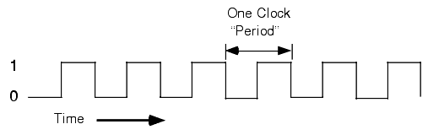
Clocks are heartbeat of the embedded systems
Clock signals are heartbeats of embedded systems. They are digital signals with varied frequency
A clock is required for running any peripheral or core of microcontroller
Exceptions: Low-power input interrupts, Reset signal

Slide 41
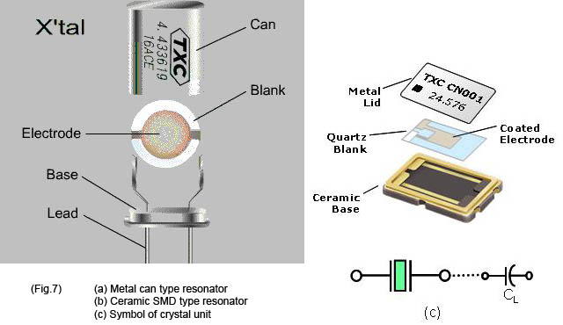
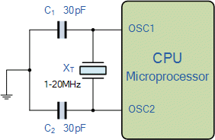
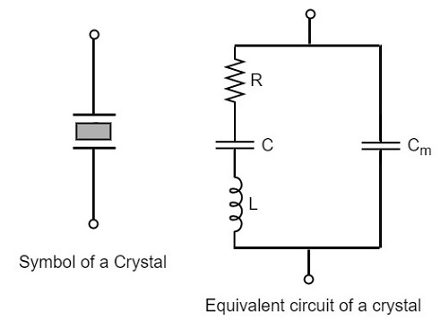
Generating clocks
External crystal oscillator
Creates clock signal
Chunk of quartz
Behaves like RLC circuit but uses less energy
Internal mechanisms
RC oscillator
Creates clock signal
Less accurate and higher energy than crystal
Phase-Locked Loop (PLL)
Multiply input to create new higher frequency clocks

Slide 42

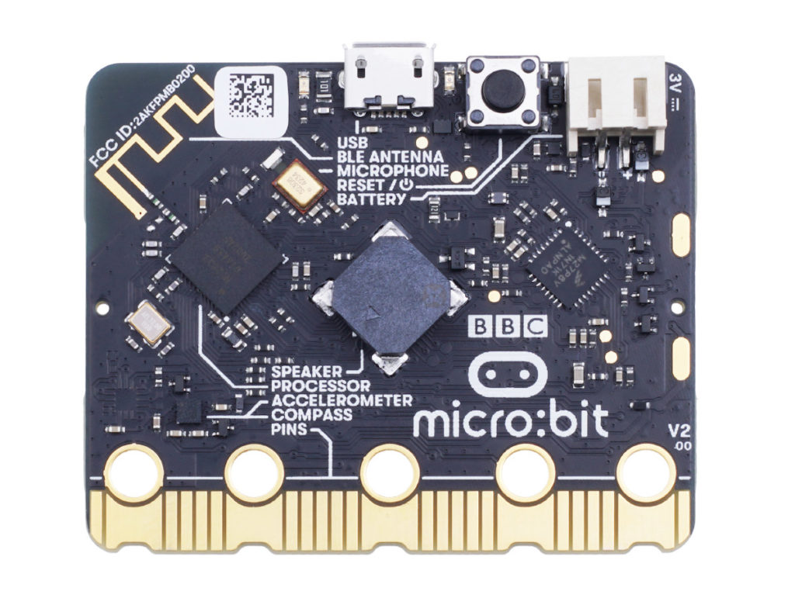
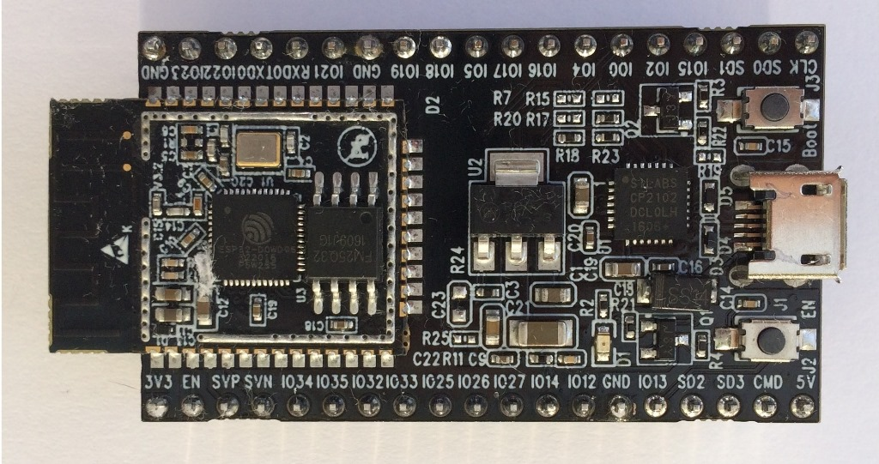
Commodity embedded platforms and crystal

Slide 43
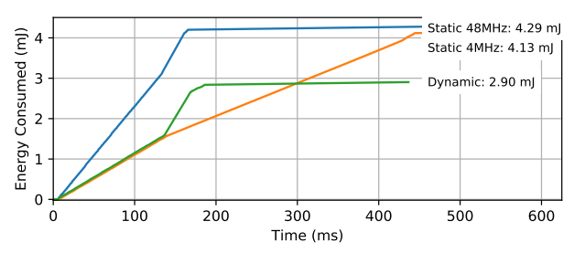
Energy consumption and clock frequency
Fundamental tradeoff between energy consumption and clock frequency
Faster clock gets things done faster but uses more energy
Slower clock uses less energy but gets things done slower
Which to use depends on the situation
Example of clock selection for a mixed load (part IO, part CPU)
Energy consumed becomes a horizontal line when the task is completed
Chiang et al. “Power Clocks: Dynamic Multi-Clock Management for Embedded Systems” EWSN 2021

Slide 44
Controlling clock frequency and power consumption
Microcontrollers provide extremely fine-grained control over clocks
Manually enable/disable clocks as needed
nRF52 instead gives almost no control but is easier to use
One 64-MHz clock for processor
Multiple peripheral clocks, but (most) peripherals are hardwired to one
16 MHz for almost all peripherals (PDM and I2S are 32 MHz)
Low-frequency 32 kHz clock for low-power peripherals
Automatically enables/disables clocks

Slide 45
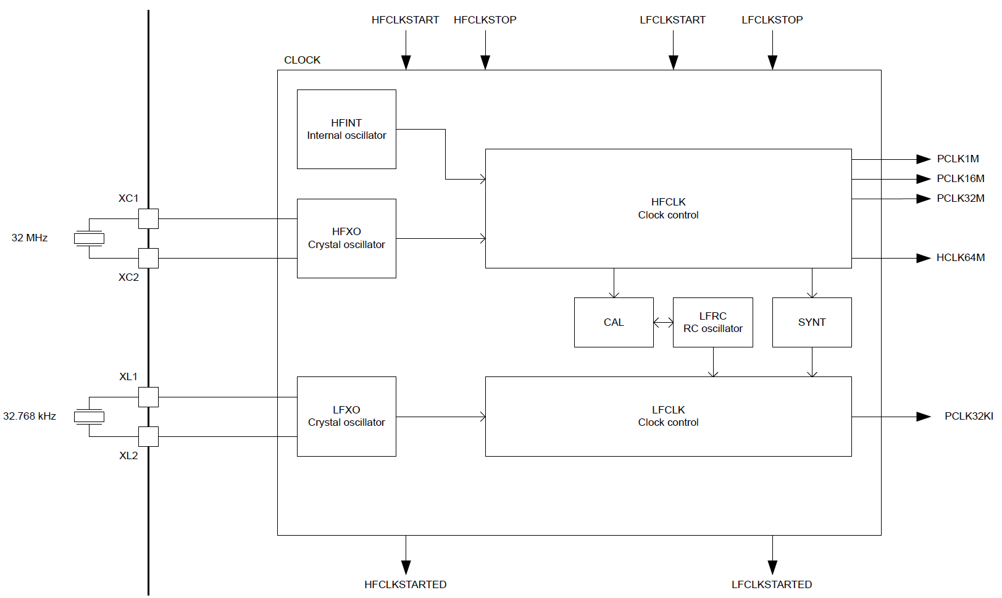
nRF52833 clocks

Slide 46
Electrical characteristics
Active power of clocks
32 kHz crystal run current: 0.23 μA
32 kHz RC oscillator run current: 0.70 μA
32 MHz crystal average run current: 300-700.00 μA
32 MHz standby current: 110.00 μA
Startup time for external crystals
32 kHz crystal: 250-500 ms (milliseconds!!!)
32 MHz crystal: 60-200 μs
Beware: switching can lead to delays and instability
nRF52 uses RC oscillator while crystal is not yet ready

Slide 47
Timer peripherals
Common need for embedded systems: sense of time
Start this behavior after a certain amount of time
Stop this behavior after a certain amount of time
Measure how much time passed between two events
Timer peripherals
Input is one of the system clocks
Counts up a register at each clock tick
Compare to saved value and trigger interrupt on match

Slide 48
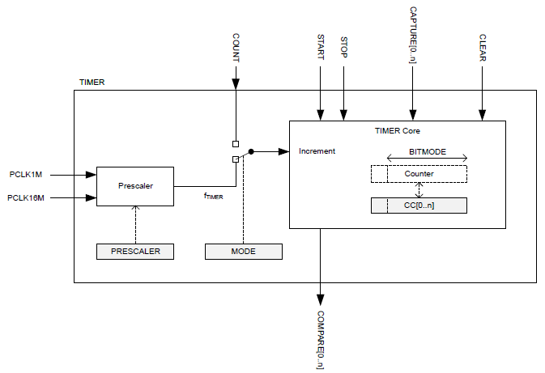
Timer peripheral on nRF52833

Slide 49
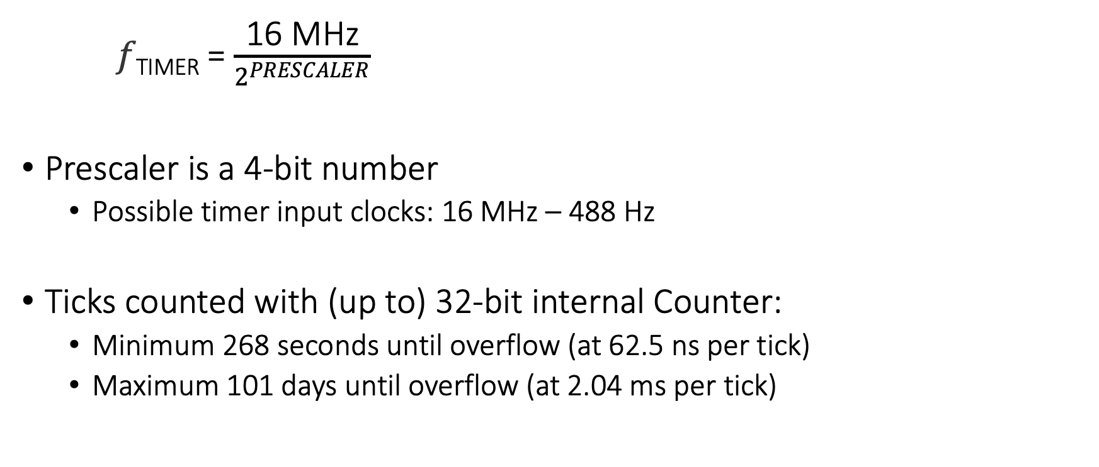
Input and Prescaler
𝑓_{TIMER} = $\frac{\text{16 }\text{MHz}}{2^{PRESCALER}}$
Prescaler is a 4-bit number
Possible timer input clocks: 16 MHz – 488 Hz
Ticks counted with (up to) 32-bit internal Counter:
Minimum 268 seconds until overflow (at 62.5 ns per tick)
Maximum 101 days until overflow (at 2.04 ms per tick)

Slide 50
Capture/Compare registers (CC)
32-bit storage registers (each timer has multiple)
Uses: capturing or comparing
On Capture[n] event
Internal Counter value copied to CC[n]
Capture used to measure durations of events
Capture can be triggered by software or by Events from other peripherals
Multiple registers to measure multi-part events

Slide 51
Comparing with CC registers
When internal Counter value equals a CC register
Corresponding Compare[n] event is triggered
Can trigger interrupts
Usually written to in advance to start/stop behavior
Toggle LED every second
Sample sensor every five minutes
Refresh LED matrix every 1/60 seconds

Slide 52
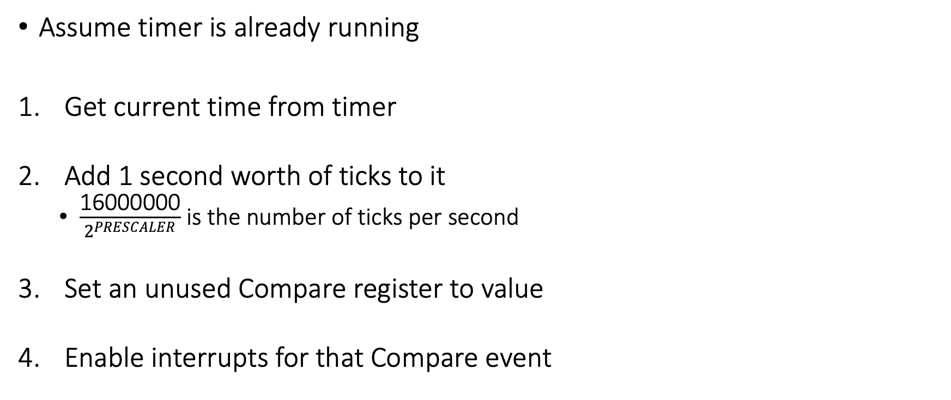
Usage: how do we set a one second timer?
Assume timer is already running
Get current time from timer
Add 1 second worth of ticks to it
$\frac{\text{16}\text{000000}}{2^{PRESCALER}}$ is the number of ticks per second
Set an unused Compare register to value
Enable interrupts for that Compare event
Warning: what if you’re setting a 1 us timer instead? Or a 100 ns timer?
Timer could expire before software writes it to the peripheral.

Slide 53
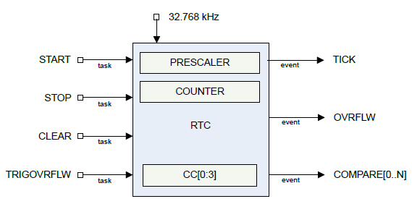
Real-time Counter
Low-power (32 kHz) version of Timer
Only a 24-bit internal Counter

Slide 54
Differences between Real-Time Counter and Timer
Runs off of LFCLK instead of HFCLK
With smaller prescaler value (4096 vs 32768)
24-bit counter vs 32-bit counter for Timer
Can read the Counter value directly
No need for Capture task
Otherwise extremely similar. Just a low-power version of Timer

Slide 55
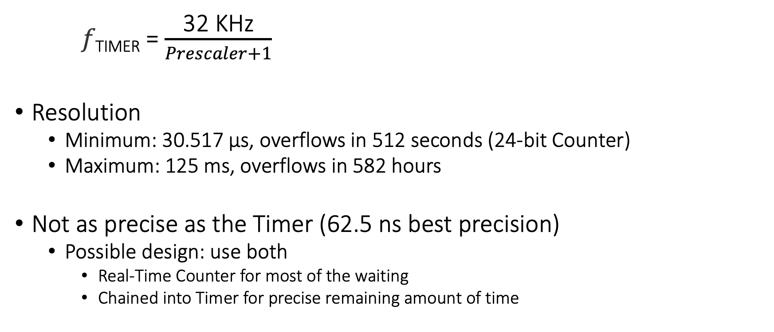
Time resolution for Real-Time Counter
𝑓_{TIMER} = $\frac{\text{32} \text{K}\text{Hz}}{Prescaler+1}$
Resolution
Minimum: 30.517 μs, overflows in 512 seconds (24-bit Counter)
Maximum: 125 ms, overflows in 582 hours
Not as precise as the Timer (62.5 ns best precision)
Possible design: use both
Real-Time Counter for most of the waiting
Chained into Timer for precise remaining amount of time

Slide 56
Roadmap of the lecture today
Let us recall what was covered in the last lecture
Interfacing I2C sensors on Arduino using library
Clock and Timers
Battery Capacity
Low-Power communication and backscatter
Notes:
Here is the roadmap of the major topics that I am going to cover during the presentation. We have already covered the exponential growth of the internet of things; next, I will talk about the critical energy challenge that can severely hinder this massive growth and preventing us from realising this immense economic value enabled by the IoT.

Slide 57
Battery-life, Power Consumption

Slide 58
Terms/Units (Quick Revision)
Voltage: Volts (V): the SI unit of electromotive force
Current: Ampere or “amp” (A) is the SI unit of electric current
Power (W): volts (V) x amps (A)
Energy (Joule): Power x Time.
Example:
A device running at 1V draws 1A.
The power consumption is therefore 1W
Energy consumed in 1s is 1J

Slide 59
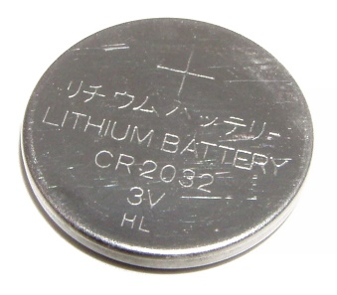
How do you measure lifespan of a battery?
The watt-hour (symbolized Wh) is a unit of energy equivalent to one watt (1 W) of power that is expended for one hour (1 h) of time.
Dell Latitude E7440 Laptop (3 cell): 34Wh - provides 1W for 34 hours.
iPad2: 25 watt-hour
An ampere-hour or amp-hour (Ah) is a unit of electric charge equal to the charge transferred by a steady current of 1A flowing for one hour:
iPad2 6930mAh, voltage = 25Wh/6.9Ah = 3.6V
Samsung S4: 2600mAh (3.7V), 9.62Wh
AA Energizer Alkaline: 2500 mAh (1.5V), 3.75Wh
Calculator Battery (CR2032): 225 mAh (3V), 0.675Wh

Slide 60
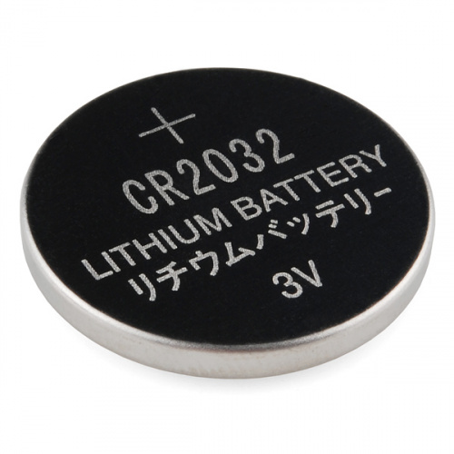
What is the capacity of the battery?
How do we calculate the lifetime of the battery in IoT devices?
We express battery capacity commonly in milliampere-hour (mAH)
Coin cell (CR2032): 240 mAh, Flexible battery (Molex): 10 mAh
How long would battery last under different device load:
Current drawn | Lifetime
240 mA | 1 h
120 mA | 2 h
1 mA | 240 h
Coin cell battery
CR 2032 (240 mAh)

Slide 61
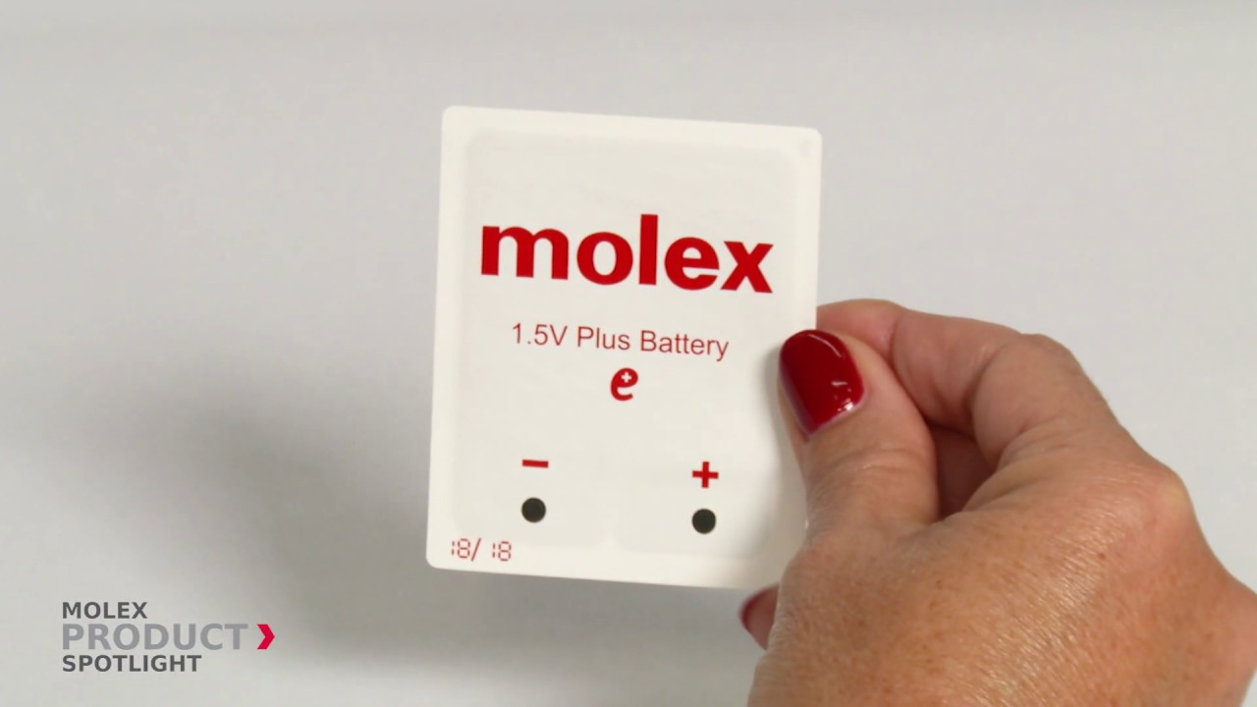
Expected lifespan of a battery in an IoT devices?
Coin cell (CR2032): 240 mAh, Flexible battery (Molex): 10 mAh
What is the battery life under different device loads:
Coin cell battery
CR 2032 (240 mAh)
Flexible Battery
(10 mAh)
Component | Current draw
Microcontroller | 200 uA
Accelerometer | 10 uA
WiFi Radio | 15 mA
Bluetooth radio | 1 mA

Slide 62
Expected lifespan of a battery in an IoT devices?
Coin cell (CR2032): 240 mAh, Flexible battery (Molex): 10 mAh
What is the battery life under different device loads:
Coin cell battery
CR 2032 (240 mAh)
Flexible Battery
(10 mAh)
Component | Current draw | Flexible Battery | Coin cell
Microcontroller | 200 uA | 50 h | 1200 h
Accelerometer | 10 uA | 1000 h | 24000
WiFi Radio | 15 mA | 45 mins | 16 h
Bluetooth radio | 1 mA | 10 h | 240 h

Slide 63
Energy Characteristics of LCD Display
Most of the power in an LCD display is consumed by the backlight, the light filter requires comparatively less power.
B Anand, K Thirugnanam, J Sebastian, PG Kannan, AL Ananda, MC Chan, RK Balan, “Adaptive display power management for mobile games,” ACM International Conference on Mobile Systems, Applications, and Services (Mobisys) 2011.

Slide 64
Energy Characteristics of OLED Display [4]
OLED display functions without a backlight
OLED displays consume less power than a LCD display when the image is dark, but more when the image is bright
Displaying different color consumed different amount of energy

Slide 65
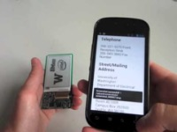
Wirelessly Powered Display

Slide 66
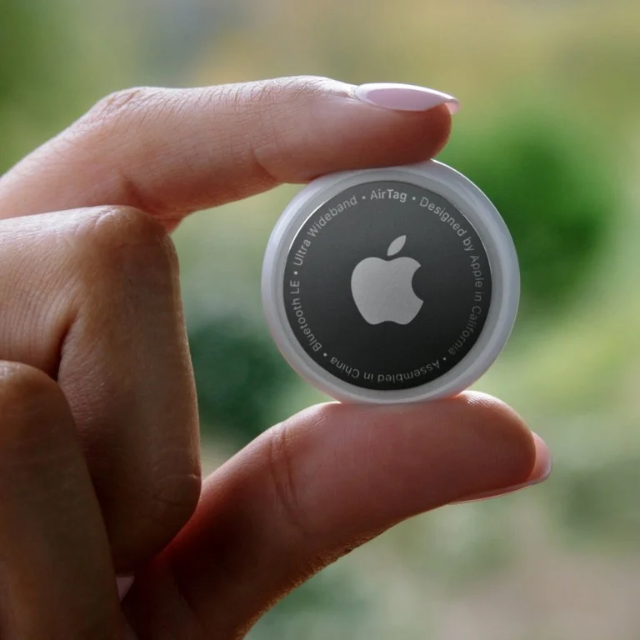
Battery Capacity: Apple AirTag

Slide 67
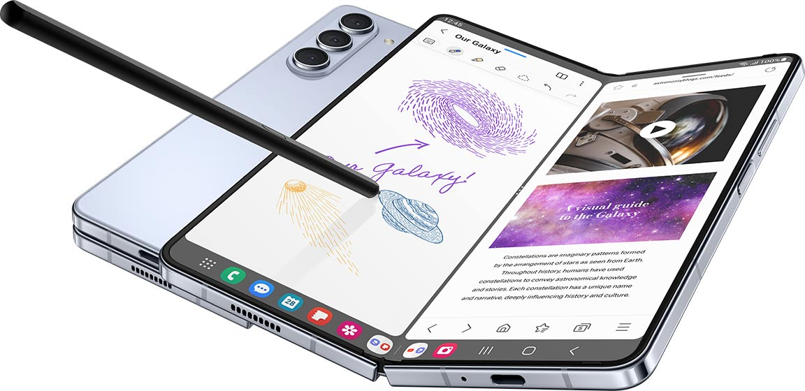
Battery Capacity: Smartphone

Slide 68
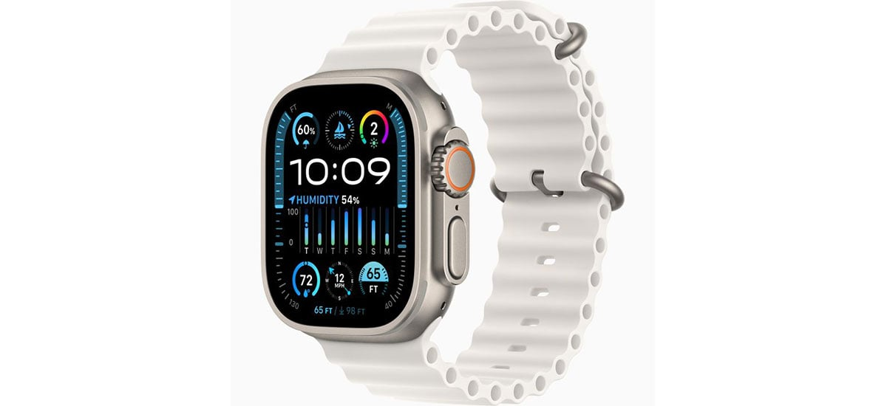
Battery Capacity: Smartwatch

Slide 69
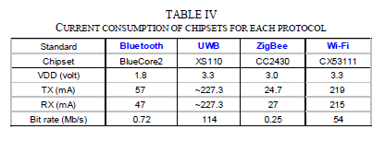
Lifespan estimation for wireless networking
A mobile device with a capacity 9.62Wh transmits continuously on:
WiFi:
Considering only network energy consumption
Power consumption: 3.3V*219mA = 722.7 mW
Duration = 9.62/0.7227 = 13.3hrs
In practice, the duration is much shorter due to other components
Bluetooth: (1.8V * 57mA = 102.6mW)
Duration = 9.62/(1.8*0.057) = 93.76hrs

Slide 70
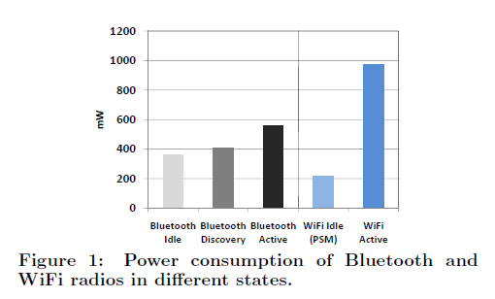
Different transmission states for wireless networking
Devices rarely transmit continuously.
Having different power states allow power consumption to be reduced
Ashish Sharma, Vishnu Navda, Ramachandran Ramjee, Venkat Padmanabhan, and Elizabeth Belding, Cool-Tether: Energy Efficient On-the-fly WiFi Hot-spots using Mobile Phones, in CoNEXT 2009.

Slide 71
Wi-Fi power consumption on a Samsung Galaxy S4
WiFi state transition for beacon communication is (relatively) fast
However, state transition for data communication is (still) slow due to driver/software overhead

Slide 72
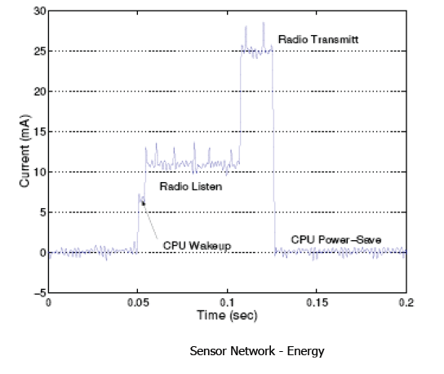
Classical embedded sensor platform: Current Consumption (MICA2 Sensor node)
What are the desirable properties for radio to operate in low power?

Slide 73
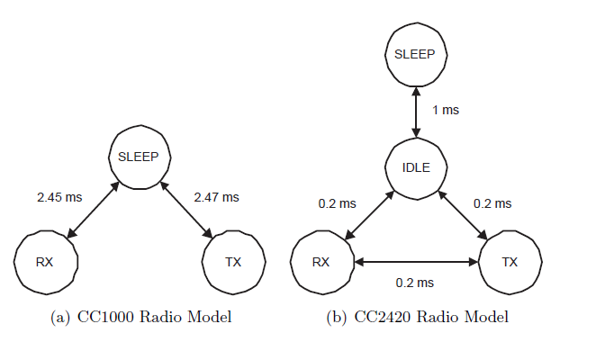
Example of Different Radio States
Energy conserved by placing the radio transceivers into low power states when they are not active

Slide 74
Different radio states of CC2650 (sensor tag)
ARM Cortex-M3: operating frequency up to 48MHz, current in ACTIVE state varies from 1.45mA to 3mA
For comparison,
RaspberryPi 3 (ARM Cortex-A53): 1W - 2W
I7-7600U@2.8GHz (laptop): 7.5W (down), 15W (typical), 25W (up)
I7-7700@3.6GHz (desktop): 65W (typical)

Slide 75
Roadmap of the lecture today
Let us recall what was covered in the last lecture
Interfacing I2C sensors on Arduino using library
Clock and Timers
Battery Capacity
Low-Power communication and backscatter
Notes:
Here is the roadmap of the major topics that I am going to cover during the presentation. We have already covered the exponential growth of the internet of things; next, I will talk about the critical energy challenge that can severely hinder this massive growth and preventing us from realising this immense economic value enabled by the IoT.

Slide 76
Low-Power Wireless Transmissions through Backscatter Communication

Slide 77
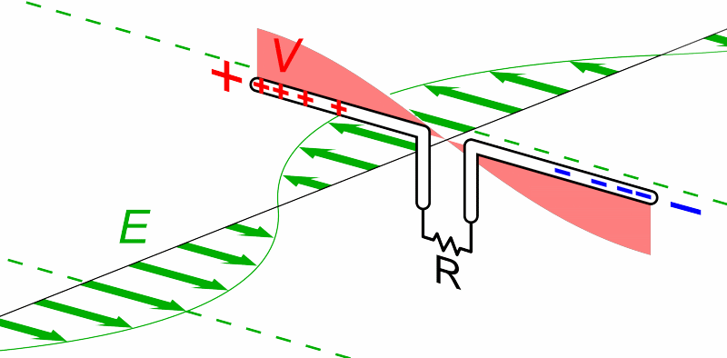
Review: What are Antennas?
High level: They convert between electric and magnetic field
Animation by Chetvorno - Own work, CC0, https://commons.wikimedia.org/w/index.php?curid=40789783
Notes:
Why do the IoT platforms suffer from this energy challenge? To understand this, we investigate the architecture of the IoT device. We show this architecture in the figure on the slide. It consists of a series of stages that enable us to sense physical phenomena, process and transmit the sensor information through a transceiver such as ZigBee/BLE/LoRa.
This architecture has remained unchanged over the past two decades. We find that during this time, sensors have become exceeding efficient. Today, we find sensors such as an accelerometer or a temperature sensor consumes just a few tens of microwatts of power consumption. However, we find that rest of the architecture components that are shown in red colour remain significantly energy expensive. To understand the reason for this significant energy asymmetry, we look at the following slide.

Slide 78
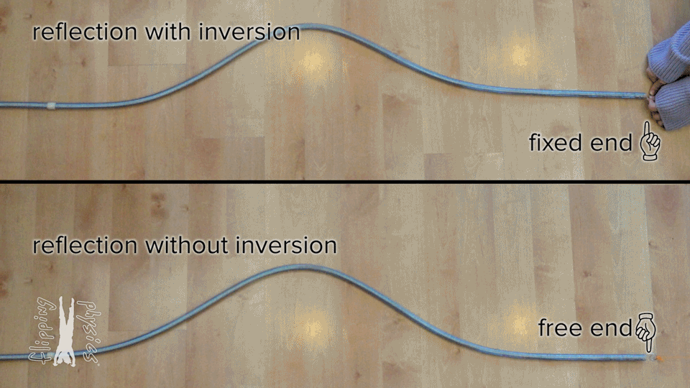
What happens if nothing ‘receives’ the wave?
From: https://www.flippingphysics.com/standing-waves.html

Slide 79
”Fixed end” and “Free end” in transmission
~
Short Circuit = “Free End”
- Reflects wave
~
Open Circuit = “Fixed End”
- Inverts wave
~
Matched Load
- Absorbs wave (no reflection)

Slide 80
Basics of backscatter communication
Vary between absorbing or reflecting signal to modulate data
Wireless transmissions at microwatts of power draw (10000x energy savings)
Frequency bands: 400 MHz, 900 MHz, 2.4 GHz
Ambient RF signal
Antenna
Reflected (backscatter) signal
RF Switch
Modulating Signal (Digital)
Backscatter tag
Reader/ Receiver

Slide 81
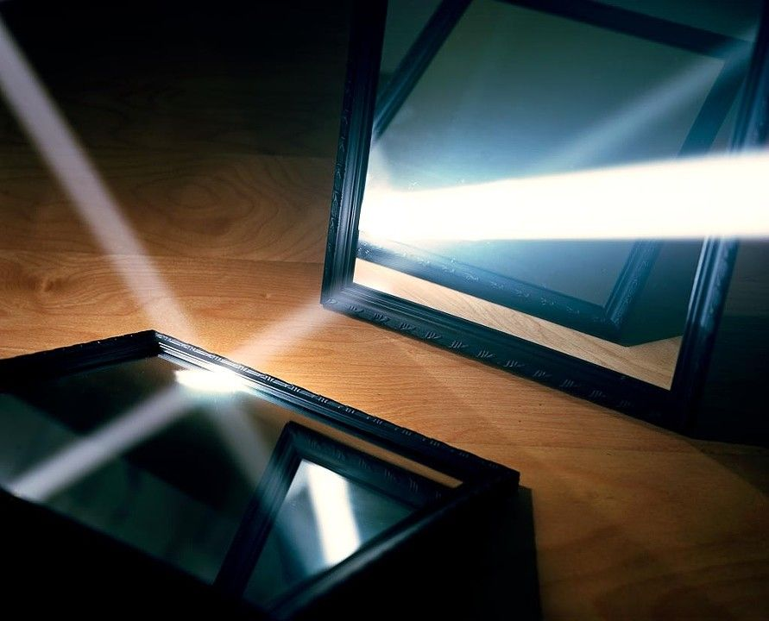
One way to understand backscatter transmissions
Notes:
++ While we are deploying an enormously large number of IoT devices, I claim that very little attention is being paid to their energy challenge.
++ Today, most IoT devices are very energy expensive, and consequently, they rely on bulky batteries such as AA/AAA sized batteries for their operation. Even when operating on these batteries, they require frequent replacement of the exhausted batteries. This can be challenging when performed at a massive scale, especially considering that we may have a trillion embedded device deployed in the world.
++ Further, it can also harm the environment. These batteries use toxic chemicals, which means now we can have billions of toxic chemicals laden batteries that would be disposed of in landfills. This is especially important as sustainability has become an essential aspect across the world; in fact, imperial college was celebrating sustainability week.

Slide 82
Backscatter transmits at (up to) 10000x lower power consumption than conventional radios
Backscatter through absorption or reflection of ambient wireless signals enables wireless transmissions at microwatts of power consumption
Ambient RF signal
Antenna
Reflected (backscatter) signal
RF Switch
Modulating Signal (Digital)
Backscatter tag
Receiver
Notes:
Backscatter communication actually help us overcome this limitation

Slide 83
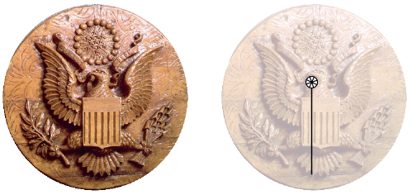
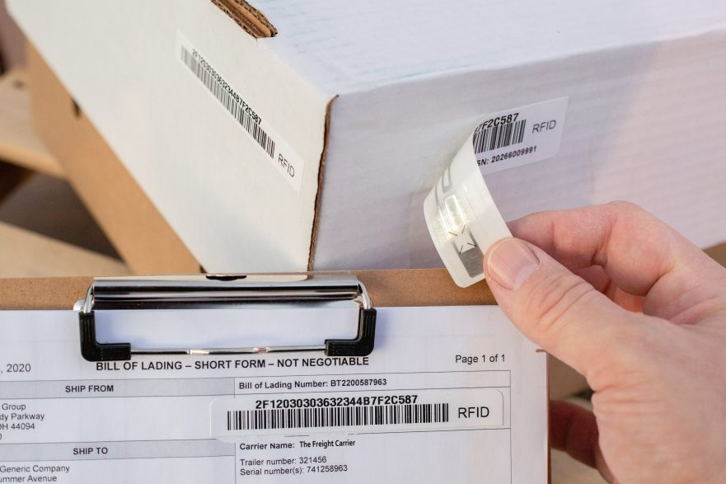
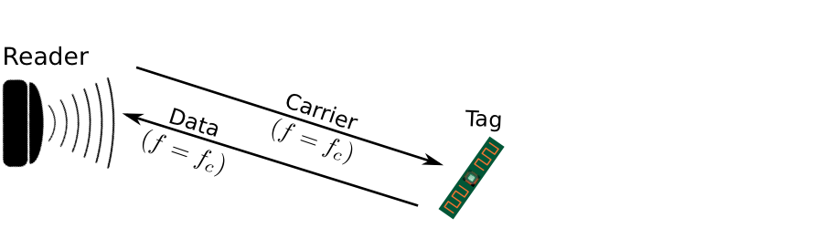
Backscatter is not a new transmission mechanism
First backscatter system: Great seal bug (The Thing) 1945
RFIDs: one of the most widely deployed backscatter system
Great Seal Bug (Backscatter device embedded for spying)
RFID System

Slide 84

RFID is everywhere nowadays
Fundamental design principle is asymmetry
Extremely simple, cheap tags
Complex readers

Slide 85
Let’s look at RFID standards to get a sense of the numbers
Low Frequency (~300 kHz) — mostly legacy
~10cm read range (inductive coupling)
High Frequency (3~30 MHz; often 13.56 MHz)
Passive: 4~7 m max
Semi-Passive: 10~30 m max
Active: 30+ m
Ultra-High Frequency (300 MHz ~ 3 GHz)
Passive: Up to 12 m (backscatter)
Active: Up to 100 m

Slide 86
RFID challenges
Essentially free communication!
What’s the cost (besides having a higher-capability device)
Difficult to reflect energy when it is already so low
Essentially double the path loss (there and back)
Range is very limited (or transmit power needs to be high)
Meters of range, maximum
Centimeters for inductive coupling
Alternatively, could decouple signal generation from reception

Slide 87

Long range backscatter transmissions using LoRea
LoRea is a long range, low-power, and low-cost backscatter architecture
System Overview
Backscatter Tag Hardware Prototype
(Peak Power of 70 µW)
Varshney et al. ”LoRea: A Backscatter architecture that achieves a long communication range” ACM SENSYS 2017
Notes:
+ Over the past several years, I have designed systems that overcome these critical limitations that have hindered the backscatter systems and have the prevented widespread adoption of the backscatter mechanisms on the Internet of Things devices. One of these systems is LoRea.
+ LoRea was presented at ACM SENSYS, which is a flagship conference in the area of embedded sensor systems. I show the architecture of LoRea on the left-hand figure on the slide. It consists of one or more commodity devices such as a smartphone or Wi-Fi router that provides the necessary carrier signal to support backscatter transmissions, a low-power backscatter tag that I had designed and transmit at a peak power of 70uw, and one or more receiver of backscatter transmissions.
+ The key highlight of LoRea was that it could achieve a significantly larger communication range than existing systems, was designed using off the shelf components and cost (few tens of USDs). Further, the backscatter tag could achieve this capability at orders of magnitude lower energy than commercially available radio transceivers.
+ How did LoRea achieve this capability? We would describe next.

Slide 88


We ran out of space while performing experiments
State-of-art few meters. We achieved kilometers, was difficult to anticipate
Initial experiments conducted near the university and a river in Uppsala
Experiment Setup
Receiving transmissions 1km away from the setup

Slide 89
LoRea outperforms state-of-the-art systems
System name | Communication range
LoRea – 868 MHz (SENSYS 2017) | 3400 m
LoRea – 2.4 GHz (SENSYS 2017) | 225 m
RFID | < 18 m
BackFi (SIGCOMM 2015) | 5 m
Passive WiFi (NSDI 2016) | 30 m
HitchHike (SENSYS 2016) | 54 m
Interscatter (SIGCOMM 2016) | 30 m
LoRa Backscatter (UBICOMP 2017) | 2800 m
Range reported are line of sight, with backscatter tag co-located with carrier source

Slide 90



LoRea achieved the highest demonstrated range
Receive up to a distance of 3.4 kilometers from tag
Highest demonstrated range. Outperforms leading labs/universities
Experiment Setup
(On a small hill)
Receiving backscatter transmissions kilometers away from setup
Experiment setup video
Notes:
Hence, to find the maximum range we could achieve with our system, we took the entire setup outside Uppsala to an open space. We kept the backscatter setup on top of a small hill, and investigated the maximum communication range that we could support.
Performing these experiments was significantly challenging, as we would setup experiment in the daytime, and by the time we would finish collecting the link metrics, it would be dawn. We also had to walk significant distances with equipment.
We found that we could communicate up to a distance of 3.4 km while consuming tens of microwatts of power for wireless transmissions at the backscatter tag. Achieving such high communication range was considered challenging or even infeasible with backscatter mechanism, and LoRea helped overturn notion that backscatter is a low range transmission mechanism.

Slide 91

LoRea bridges the energy asymmetry between communication (TX), sensing and processing
Component | Power Consumption
LoRea (Transmissions) | 70 µW (868 MHz)
Conventional Transceiver | Tens to hundreds of mW’s
Microcontroller (Apollo3) | 100s of µW’s
Sensors | Few to tens of µW’s
Off-the-shelf hardware for transmission and receptions. Tens of USD
Overturn notion that backscatter is a short-range transmission mechanism
LoRea transmits at similar power consumption as a sensor
Texas Instruments CC1310 Launchpad: Receiver
Backscatter Tag Hardware Prototype
(Peak Power of 70 µW)
Notes:
+ Thus, with LoRea, we were able to design a backscatter system that was able to overcome the range and cost limitations that had limited all the existing backscatter system, and had hindered the widespread usage of the mechanism on the IoT devices
.
+ In fact, the backscatter tag even though it was designed using off-the-shelf components is orders of magnitude more efficient than commercial transceivers while supporting orders of magnitude lower power consumption.
+ the entire backscatter setup costs just few tens of USDs, which dramatically lowers the cost of infrastructure required to support the backscatter tags and carrier emitter device.

Slide 92
Let’s look at the battery-life again
Notes:
++ Over the past few years, I have designed several backscatter and beyond backscatter systems that precisely overcome these critical challenges that have limited the widespread deployment of backscatter on IoT devices.
++ The research vision that I have pursued and would like to pursue as a faculty member is to enable a massive deployment of IoT devices by bridging the energy asymmetry between sensing, computation and communication blocks by designing novel platforms and communication mechanisms. I am going to describe some of my research contributions next.

Slide 93
What is the expected lifespan of a battery?
Coin cell (CR2032): 240 mAh, Flexible battery (Molex): 10 mAh
Backscatter transmitter: (LoRea, SENSYS 2017) – 35 uA
Let’s estimate long would battery last under different device load:
Component | Current draw | Flexible Battery | Coin cell
Microcontroller | 200 uA | 50 h | 1200 h
Accelerometer | 10 uA | 1000 h | 24000
WiFi Transmitter | 15 mA | 45 mins | 16 h
Bluetooth Transmitter | 1 mA | 10 h | 240 h
Backscatter Transmitter | 35 uA | 285.7 h | 6857 h

Slide 94

What's next? Embedded systems on harvested energy
𝜇W
Energy harvester
Microwatts of power available to harvest from ambient sources
Notes:
++ The high-power consumption for the IoT platforms also blocks an important and promising direction to enable the sustainable deployment of large-scale embedded devices. This is to eliminate batteries from these platforms altogether. If we eliminate batteries, how do we power these devices?
++We use the fact that ambient energy sources surround us. We are constantly bombarded with radio frequency transmissions such as television, wifi, radio signals, or we have waste heat energy sources, or the indoor light is ubiquitous. All these sources could be harvested to derive energy to power the IoT devices and platforms and eliminate the overhead associated with batteries on these platforms. However, the challenge that we encounter is that we could only derive microwatts of power from these ambient sources, which is sufficient to power the sensors and microcontrollers. However, we need orders of magnitude higher power for operating radio transceivers such as LoRa. This makes it challenging, if not impossible, to power sensors through energy derived from the environment.

Slide 95
Embedded systems on harvested energy
Batteries/Capacitors can potentially be recharged by environmental effects
Some examples
Solar : solar cell
Wind: micro wind turbine can be used to harvest wind energy readily available in the environment in the form of kinetic
Thermal: capture energy from industrial equipment, structures, and even the human body.
Vibration: vibration from engines can stimulate piezoelectric materials, as can the heel of a shoe.
Kinetic: translate movement to change in electromagnetic flux
Radio Frequency (RF): convert ambient RF signal into energy (demo video)

Slide 96

Demo: Gesture recognition
Varshney et al. “Battery-free Visible Light Sensing” ACM VLCS 2017 (Best Paper)
ACM Mobicom 2017 SRC (Graduate winner)

Slide 97


EDISON : Communication through visible light
Backscatter modulator
LiFi Front-end
MCU
Power management
Galliesto et al. ” Two to tango hybrid light and backscatter networks for next billion devices” ACM MOBISYS 2020
(co-primary author with me)
Notes:
External power management for convenience

Slide 98

Energy flow within the EDISON tag
Notes:
Only power management

Slide 99








Overview of the Edison system
Lighting Network
0
1100
1
0
0
11
RF Carrier
RF Router
(edge device)
RF Backscatter
Battery-free device
Notes:
obvious

Slide 100
Roadmap of the lecture today
Let us recall what was covered in the last lecture
Interfacing I2C sensors on Arduino using library
Clock and Timers
Battery Capacity
Low-Power communication and backscatter
Notes:
Here is the roadmap of the major topics that I am going to cover during the presentation. We have already covered the exponential growth of the internet of things; next, I will talk about the critical energy challenge that can severely hinder this massive growth and preventing us from realising this immense economic value enabled by the IoT.

Slide 101
Embedded Software Programming
Ambuj Varshney
ambujv@nus.edu.sg
Notes:
++ Thank you for inviting me to give this talk
++ In this talk, I will present a pathway that can enable us to make wireless embedded systems ubiquitous. I will describe my previous research efforts that tackle the critical challenges that limit the growth of wireless embedded systems. These are related to the growing energy asymmetry that exists between sensing, computation and communication blocks on these platforms.
++ Finally, I will conclude my talk by covering the research agenda that I would like to work on as a faculty member.

